Slide 1
Cognitive Adaptations
for
Social Exchange
Leda Cosmides & John Tooby
Center for Evolutionary Psychology
Dept. of Psychological & Brain Sciences
University of California, Santa Barbara
www.cep.ucsb.edu

Slide 2
Four innovations leading to evolutionary psychology
1. The cognitive revolution provided a precise language for describing mental mechanisms: as programs that process information.
2. Advances in paleoanthropology, hunter-gatherer studies and primatology provided data about the adaptive problems our ancestors had to solve to survive and reproduce and the environments in which they did so.
3. Research in animal behavior, linguistics, and neuropsychology showed that the mind is not a blank slate, passively recording the world. Organisms come “factory-equipped” with knowledge about the world, which allows them to learn some relationships easily, and others only with great effort, if at all.
4. The revolution that placed evolutionary biology on a more rigorous, formal foundation of replicator dynamics & game theory, clarifying how natural selection works, what counts as an adaptive function, and what the criteria are for calling a trait an adaptation. (George Williams, W. D. Hamilton, John Maynard Smith, Richard Dawkins)
ethology: 2, 3 sociobiology: 2, 3, 4 ev psych: 1,2,3,4

Slide 3
Evolutionary psychology
Human Nature:
  the set of species-typical information-processing programs that reliably develop in the human brain (i.e., the architecture of the human mind)
Key insight:
  The programs comprising the human mind were designed by natural selection to solve the adaptive problems faced by our hunter-gatherer ancestors. Knowing this helps one discover their structure.

Slide 4
Evolutionary psychology: 5 step research program
Identify an enduring adaptive problem our hunter-gatherer ancestors faced (e.g., cooperating with others; keeping track of information relevant to foraging; avoiding predators). This involves combining results from evolutionary game theory, hunter-gatherer studies, paleoanthropology, primatology, etc.
Do a task analysis, derive hypotheses about cognitive programs. What design features would a program need to have to solve that adaptive problem well? Use this task analysis to derive hypotheses about the structure of the relevant programs.
Test hypotheses in laboratory: Using standard experimental methods from cognitive and social psychology (and experimental economics), see if there is evidence that the proposed programs exist (This includes tests against alternative computational designs that have been proposed)
Identify the program’s neurological basis (as another check of its reality)
Test cross-culturally (field site in Ecuadorian Amazon)

Slide 5
Causal connections between the 4 developments
The brain is an evolved computer (#1), whose programs were sculpted over evolutionary time by the ancestral environments and selection pressures experienced by the hunter-gatherers from whom we are descended (#2 and #4).
Individual behavior is generated by this computer, in response to information that the person experiences (#1).
Although the behavior these programs generate would, on average, have been adaptive (reproduction-promoting) in ancestral environments, there is no guarantee that it will be so now. Modern environments differ importantly from ancestral ones (esp. social environments).

Slide 6
Causal connections between the 4 developments
The brain must be comprised of many different programs, each specialized for solving a different adaptive problem our ancestors faced – i.e., the mind cannot be a blank slate (#3).
  This can be shown by using results from evol. game theory (#4) to define adaptive problems, and then carefully dissecting the computational requirements of any program capable of solving those problems
  (e.g., a program that is well-designed for choosing mates will embody different preferences and inferences than one that is well-designed for choosing foods).
If you want to understand human culture and society, you need to understand these domain-specific programs.

Slide 7
Reasoning instincts
Complexly specialized for solving an adaptive problem
Reliably develop in all normal human beings
Develop without any conscious effort
Develop without any formal instruction
Applied without awareness of their underlying logic
Distinct from more general abilities to process information or behave intelligently
after Pinker, 1994

Slide 8
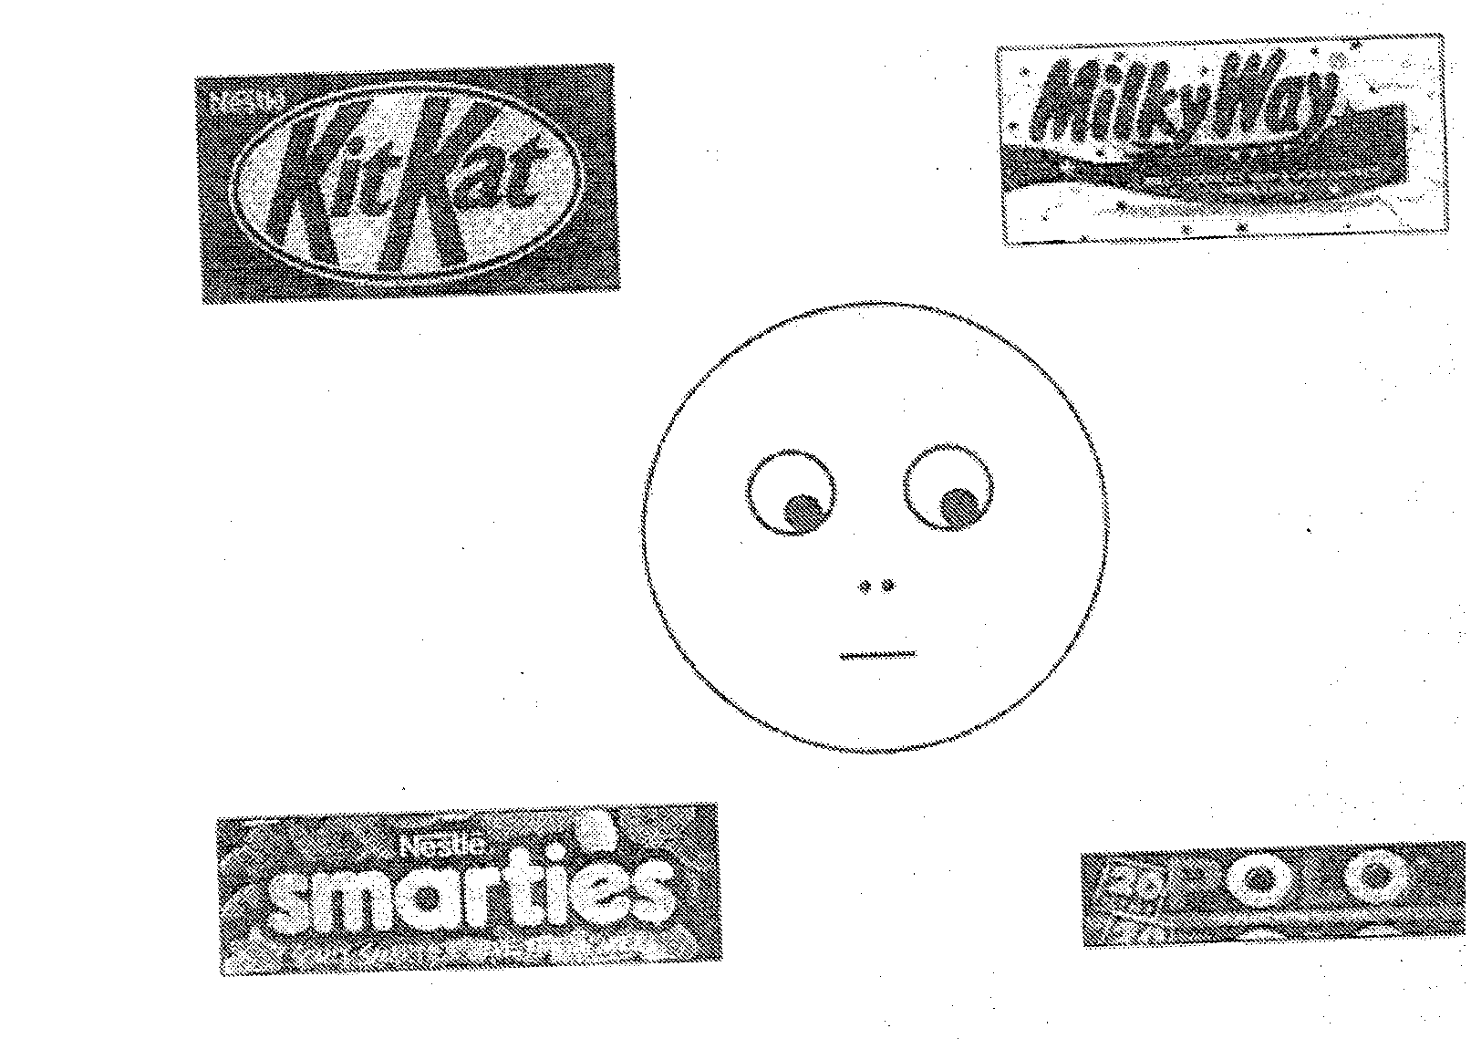
Charlie task (Baron-Cohen, 1995)

Slide 9
Social Exchange
Cooperation for mutual benefit
Reciprocity, reciprocal altruism, tit for tat
  Trivers, 1971, Axelrod & Hamilton, 1981, Axelrod, 1984
  Usually modeled as a repeated Prisoners’ Dilemma

Slide 10
Evidence that social exchange is a long-enduring adaptive problem
Universal
Highly elaborated in all cultures
  Reciprocal gift-giving, food sharing, market pricing, symbolic, implicit
Not a recent cultural invention
  No evidence of point of origin, of having spread by contact, of being absent in any culture
Paleoanthropological evidence
  Hunter-gatherer archaeology: 2 million years old
Primate evidence 5-30 million years old?
Conclusion:
Social exchange is an ancient, pervasive, and central part of human social life

Slide 11
Social contracts
Example:
“If you give me your watch, I will give you $100”
A social contract is a situation in which one is obligated to satisfy a requirement of some kind, in order to be entitled to a benefit.
  The requirement is imposed because its satisfaction creates a situation that benefits the party that imposed it

Slide 12
The mind's definition of cheating ...
...should be content-dependent:
a cheater is someone who illicitly took a benefit
i.e., a person who took the benefit without having satisfied the requirement.
(regardless of logical category)
This also means:
Which events count as cheating depends on whose perspective you take...

Slide 13
Which events count as cheating depends on whose perspective you take
“If you give me your watch, I will give you $100”
If P then Q
I cheated you if:
I accepted your watch BUT I did not give you $100
P and not-Q
You cheated me if:
You accepted my $100 BUT you did not give me your watch
Q and not-P
Note: definition of logical violation is content-independent: Given If P then Q, always P & not-Q (no matter what these refer to)

Slide 14
Conditional reasoning & reciprocation
Reciprocation is, by definition, social behavior that is conditional:
you deliver a benefit conditionally
  i.e., conditional on the other person doing what you required in return
Understanding it requires conditional reasoning.
Therefore, investigations of conditional reasoning can serve as a test case.

Slide 15
What kind of reasoning instincts govern how we think about social exchange?
Formal logic has rules for conditional reasoning
In reasoning about social exchange, does the human mind apply:
  Reasoning procedures that embody formal logic
    Domain general, content-free
  Or reasoning procedures that are specialized for social exchange
    Domain specific, content-rich

Slide 16
Conditional reasoning
Is the cognitive machinery that causes good conditional reasoning general – does it operate well regardless of content? (blank slate-type theory)
OR
Do our minds include cognitive machinery that is specialized for reasoning about social exchange?
…alongside other domain-specific mechanisms, each specialized for reasoning about a different adaptive domain involving conditional behavior…
The Wason selection task is a test of conditional reasoning…which we used to test these hypotheses.

Slide 17
Ebbinghaus disease was recently identified and is not yet well understood. So an international committee of physicians who have experience with this disease was assembled. Their goal was to characterize the symptoms, and develop surefire ways of diagnosing it.
Patients afflicted with Ebbinghaus disease have many different symptoms: nose bleeds, headaches, ringing in the ears, and others. Diagnosing it is difficult because a patient may have the disease, yet not manifest all of the symptoms. Dr. Buchner, an expert on the disease, said that the following rule holds:
“If a person has Ebbinghaus disease, then that person will be forgetful.”
If P then Q
Dr. Buchner may be wrong, however. You are interested in seeing whether there are any patients whose symptoms violate this rule.
The cards below represent four patients in your hospital. Each card represents one patient. One side of the card tells whether or not the patient has Ebbinghaus disease, and the other side tells whether or not that patient is forgetful.
Which of the following card(s) would you definitely need to turn over to see if any of these cases violate Dr. Buchner's rule: “If a person has Ebbinghaus disease, then that person will be forgetful.” Don't turn over any more cards than are absolutely necessary.
has Ebbinghaus disease
does not have Ebbinghaus disease
is forgetful
is not forgetful
P not-P Q not-Q
Only 26% answer P & not-Q

Slide 18
Teenagers who don’t have their own cars usually end up borrowing their parents’ cars. In return for the privilege of borrowing the car, the Goldstein’s have given their kids the rule,
“If you borrow my car, then you have to fill up the tank with gas.”
If P then Q
Of course, teenagers are sometimes careless and irresponsible. You are interested in seeing whether any of the Goldstein teenagers broke this rule.
The cards below represent four of the Goldstein teenagers. Each card represents one teenager. One side of the card tells whether or not a teenager has borrowed the parents’ car on a particular day, and the other side tells whether or not that teenager filled up the tank with gas on that day.
Which of the following card(s) would you definitely need to turn over to see if any of these teenagers are breaking their parents’ rule: “If you borrow my car, then you have to fill up the tank with gas.”
Don't turn over any more cards than are absolutely necessary.
borrowed car |  | did not borrow car |  | filled up tank with gas |  | did not fill up tank with gas
P not-P Q not-Q
76% answer P & not-Q

Slide 19
How the mind sees this problem...
The mind translates social contracts into representations of benefits and requirements, and it inserts concepts such as “entitled to” and “obligated to”, whether they are specified or not.
“If you borrow my car, then you have to fill up the tank with gas.”
“If you take the benefit, then you are obligated to satisfy the requirement.”
If P then Q
borrowed car |  | did not borrow car |  | filled up tank with gas |  | did not fill up tank with gas
Accepted the benefit |  | Did not accept the benefit |  | Satisfied the requirement |  | Did not satisfy the requirement
P not-P Q not-Q

Slide 20
Do people have cognitive adaptations that are specialized for reasoning about social contracts?
In particular, do people have inference procedures specialized for cheater detection?
We approached this question by studying human reasoning. A large literature already existed that showed that people are not very good at detecting violations of conditional rules, even when these rules deal with familiar content drawn from everyday life. To show that people who ordinarily cannot detect violations of conditional rules can do so when that violation represents cheating on a social contract would constitute (initial) evidence that people have reasoning procedures that are specially designed for detecting cheaters in situations of social exchange.

Slide 21
Programs specialized for social exchange
What design features should they have?
Cheater detection
Familiarity not relevant
Adaptive logic, not formal logic
Benefits and costs relevant
Cheating versus innocent mistakes
Perspective-dependent definition of cheating
Cross-cultural development

Slide 22
Design feature: Familiarity not relevant
Example:
“If a man eats cassava root, then he must have a tattoo on his face”
Vary context to change interpretation of the rule
  Social contract context: eating cassava root is a rationed benefit
  Descriptive context: no rationed benefits, rule purports to describe eating habits

Slide 23
Social contract reasoning: Unfamiliar content
Standard form
Exp 1: Social contract = social rule
Exp 2: Social contract = personal exchange
Cosmides, 1985, 1989

Slide 24
Design feature: Social contract inference rules ≠ logical inference rules
Does social contract content merely activate logical reasoning? (predicate calculus)
  E.g., in logic: If P then Q ≠ If Q then P
Or does it activate a logic peculiar to social exchange?
  In social exchange, If P then Q = If Q then P, but only if P is a rationed benefit and Q is a requirement. I.e.:
  “If you take the benefit, then you are obligated to satisfy the requirement” does imply
  “If you satisfy the requirement then you are entitled to the benefit”

Slide 25
Cheating ≠ logical violation
1. Standard: “If you give me your watch, I will give you $100”
If P then Q
2. Switched: “If I give you $100, then give me your watch”
I cheated you if:
 | You gave me your watch | I did not give you $100
Logically correct?
1. Standard format | P | not-Q | YES
2. Switched format | Q | not-P | NO
In mentalese... | I accepted the benefit from you | I did not satisfy your requirement

Slide 26
Social contract reasoning: Unfamiliar content
Switched form
Exp 3: Social contract = social rule
Exp 4: Social contract = personal exchange
Cosmides, 1985, 1989

Slide 27
Does social contract reasoning dissociate from more general forms of reasoning?
Schizophrenics |  | Controls
Social contracts + General reasoning – |  | Social contracts + General reasoning +
Prof. Vera Maljkovic, Dept. of Psychology, University of Chicago
Maljkovic, 1987

Slide 28
Design feature: Perspective-dependent definition of cheating
If P then Q
“If an employee is to get a pension, then he must have worked for the firm for over 10 years.”
What counts as a violation? Depends on perspective:
Employer worried about employee cheating:
  Got a pension = P worked < 10 years = not-Q
  P & not-Q: Logically correct
Employee worried about employer cheating:
  worked > 10 years = Q no pension = not-P
  Q & not-P: Logically incorrect
Gigerenzer & Hug, 1992

Slide 29
Predictions, Perspective Change
= Employer perspective
= Employee perspective
Logic & most other theories
Social contract theory
P & not-Q
Q & not-P
P & not-Q
Q & not-P

Slide 30
Results, Perspective Change
= Employer perspective
= Employee perspective
Therefore:
What counts as cheating is computed in a perspective-dependent way
Performance good from each perspective
Not logic
P & not-Q
Q & not-P
Gigerenzer & Hug, 1992

Slide 31
How domain-specific is the mechanism?
(general to all deontic rules?)
Permission schema (Cheng & Holyoak, 1985)
Rule 1: If the action is to be taken, then the precondition must be satisfied.
Rule 2: If the action is not to be taken, then the precondition need not be satisfied.
Rule 3: If the precondition is satisfied, then the action may be taken.
Rule 4: If the precondition is not satisfied, then the action must not be taken.

Slide 32
The domain of permission rules is larger than for social contracts
Permission rules
Social contracts
(regulate access to benefits)
All social contracts are permission rules
But not all permission rules are social contracts...
Some permission rules are NOT social contracts.

Slide 33
Design feature: Benefits should matter
Context: Fictitious culture in which the elders have made laws governing what adolescents are allowed to do.
Permission rule template:
If one is to take action A, then one must satisfy precondition R.
1. “If one is going out at night, then one must tie a small piece of red volcanic rock around one’s ankle.”
2. “If one is staying home at night, then one must tie a small piece of red volcanic rock around one’s ankle.”
3. “If one is taking out the garbage, then one must tie a small piece of red volcanic rock around one’s ankle.”
1-3 are all permission rules (all fit the template)
But given how teen-agers see going out at night (as a benefit or privilege), only #1 regulates access to a benefit and is therefore a social contract.

Slide 34
Result: Benefits matter
Kalama problem
Sears problem
benefit neutral chore
benefit no ben. no ben.
cost cost no cost
Cosmides & Tooby, 1992; Cosmides, Barrett & Tooby, 2010

Slide 35
So how domain-specific is the mechanism?
It does not detect violations of:
all permission rules
all deontic rules
all social norms
Benefit results rule out:
Permission schema theory
Deontic theories (e.g., Fodor, 2000)
Social norm theories (it is not an adaptation for detection violations of social norms)

Slide 36
Can general skill acquisition explain results?
General skill acquisition
  Economic perspective
  Concern with utility consequences
  Common sense!
Predicts good violation for all social contracts
  Skill at detecting cheating events
  Reason for violation irrelevant
Why?

Slide 37
General skill acquisition, economics, utility consequences…
Become skilled at solving problems one is motivated to solve, such as those with economic consequences
When a social contract is violated, party providing benefit suffers a loss in utility
  If these cases are detected, victim could recoup loss, get what s/he is owed
A lifetime of not getting what you are entitled to should build skill at detecting violations of social contracts—cheating events

Slide 38
Design feature:
Cheating versus Innocent Mistakes
Is the mechanism designed to look for:
Cheaters?
  Individuals with a disposition to cheat?
  OR
Events in which a social contract has been violated?
  Cases in which someone has been cheated?
Cosmides, Barrett, & Tooby, PNAS 2010

Slide 39
Evolvability constraint (game theory)
Evolution of reciprocity requires ability to avoid cooperating with DESIGNS that cheat
  Otherwise cheaters outcompete cooperators
  e.g., Tit For Tat can resist invasion by Always Defect, and avoid being exploited by contingent cooperators who occasionally cheat
Detect cheaters
  A form of PERSON categorization

Slide 40
Evolvability constraint
But even a cooperator may sometimes fail to reciprocate by MISTAKE
  Fitness error to avoid this individual; strings of benefit-benefit transactions possible

Slide 41
Accidental failures to reciprocate…
Result in cheating
Without revealing presence of a cheater
An EVENT has occurred in which the provisioner has not gotten what he is entitled to
  Provisioner has been cheated
Without revealing the presence of a PERSON with a disposition to cheat
Innocent mistakes can dissociate
  event categorization (someone was cheated)
  from person categorization (cheater detection)

Slide 42
A cheater is:
An agent who
Takes the rationed benefit offered in a social exchange
But fails to meet the provisioner’s requirement
And does so by intention/ calibration rather than by mistake or accident
i.e., an agent with a disposition to cheat
  By virtue of his/her calibration or design

Slide 43
Intentionality series, exps 1 and 2
Identical social contract rules in all conditions
  A deontic permission rule involving utilities (deontic: involving concepts of entitlement, obligation or prohibition)
  Violation = Event where someone has been cheated
Vary
  Benefit to potential violator: Would potential violator get provisioner’s benefit or not?
  Intention to violate: Is potential violator acting intentionally or making innocent mistakes?
  Ability to violate (exp 2 only)
Cosmides, Barrett & Tooby, PNAS 2010

Slide 44
Exp 1: Cheating vs. Sabotage vs. Innocent Mistakes
Same social contract rule used in all three conditions:
If a student is to be assigned to Dover High School, then that student must live in Dover City.
Context explains:
Dover High is a good school, Hanover High is not
People living Dover City pay high taxes to support this good school.
People living in Hanover and other cities do not (even though they are equally prosperous).
Board of Education took these factors into account when creating the rule
You supervise volunteers at the Board who are sorting student documents

Slide 45
Exp 1: Cheating vs. Sabotage vs. Innocent Mistakes
Same social contract rule used in all three conditions:
“If a student is to be assigned to Dover High School, then that student must live in Dover City.”
If P then Q
Indicate only those card(s) you definitely need to turn over to see if the documents of any of these students violate the rule.
Dover High School
Hanover High School
Dover City
town of Hanover
P not-P Q not-Q

Slide 46
What varies? The potential rule violators
Cheater condition: Mothers with high school age children have volunteered to sort documents at the local board of education; some may have sorted their own children’s documents, may have cheated.
  Intend, get benefit regulated by the social contract
Sabotage condition: Women who are mad at you for having fired their best friend; they intend to violate the rule to make chaos that will make you look incompetent in eyes of your boss.
  Intend, do not get benefit regulated by the social contract
Innocent mistake condition: Absent minded elderly ladies who work at the board of education are sorting the documents. They may have made some mistakes.
  No intention, no benefit

Slide 47
Identical social contract rules
Cheating
Sabotage
Mistake
Cosmides, Barrett, Tooby, PNAS 2010 (Exp 3)

Slide 48
Exp 2: Full parametric design (8 conditions)
Same social contract rule used in all 8 conditions
Varied:
Benefit present vs absent
  Can volunteers get benefit regulated by the rule by breaking it?
    Mothers vs. volunteers with no high-school age children
Intention present vs. absent
  Did volunteers intend to violate rule or are they honest people who may have made mistakes?
    In Benefit absent condition: “mischeviously intend” to provide a motive
Ability present vs. absent
  Does the situation make violating easy, or are there anti-cheating measures in place? (redacted docs)
    If situation makes violations unlikely, search for violations is unlikely to reveal individuals with a disposition to cheat

Slide 49
Vary properties of violator; same social contract
Benefit: would violator get benefit regulated by rule?
Intention: Is violation on purpose?
Ability: Is it easy to violate?
Cosmides, Barrett, Tooby, 2010; Barrett, 1999

Slide 50
Cue-activated system regulates cheater detection
Each cue independently and additively contributes to activation of the cheater detection system
Best performance when violator:
  would get Benefit regulated by social contract
  + Intends to violate
  + has Ability to violate
Removing 1 cue drops ~20 points
Remove 2 cues drops ~40 points

Slide 51
Results rule out all deontic counter-theories
These depend on whether the rule is interpreted as being a deontic rule, or a deontic rule with utilities
All rules had the exact same interpretation: as a social contract (deontic with utilities)
Yet performance dropped when looking for violations would not reveal individuals with disposition to cheat

Slide 52
Results rule out general skill acquisition or utility-based learning (assumed in economics)
“Consequences for utility” inadequate as an explanation for when violation detection is observed
  These exist in all cases (Board doesn’t get what it wants—presumably to incentivize tax support)
  In Benefit present conditions, also true that violators are getting an unearned benefit
    Yet removing Intention and Ability drops performance!

Slide 53
Relevance theory cannot explain the results (Sperber, Cara & Girotto, 1995)
Relevance theory predicts good violation detection for all deontic rules—especially those involving utilities.
  Based on interpretation of the deontic rule (which we held constant). Yet ranged from 23%-64%!
(A save?) Best performance when violations of the social contract invite relevant inferences?
  But BI, BA, IA, BIA all invite relevant inferences
    Yet performance on BIA > BI, BA, IA
  & even though BI invites more relevant inferences than BIA
    Violation of BI would imply: not only do cheaters exist, but the countermeasures taken were inadequate!

Slide 54
Cheating versus Innocent Mistake
What do the results mean?
Cheating by design, not by mistake
Mechanism is functionally designed to look for cheaters—individuals with a disposition to cheat
Just how specialized is the cheater detection mechanism?
It’s so freakin’ specialized!

Slide 55
Generic Structure of a Precaution Problem
The following rule holds:
“If you engage in the hazardous activity,
then you must take the precaution.”
Which of the following card(s) would you definitely need to turn over to see if any of these people are breaking the rule?
engaged in hazardous activity |  | did not engage in hazardous activity |  | took the precaution |  | did not take the precaution
P not-P Q not-Q
Precaution rules elicit good violation detection

Slide 56
How domain-specific?
Permission rules
Social contracts
Precaution rules
All social contracts are permission rules
All precaution rules are permission rules
There are permission rules that are neither social contracts nor precautions
Social contracts regulate access to benefits, whereas
Precaution rules say what you should do to avoid harm

Slide 57
One mechanism or two?
Is reasoning about social contracts and precaution rules governed by two, functionally distinct mechanisms?
Or by a single mechanism operating at a more abstract level?
Single mechanism account predicts that brain damage affecting social contract reasoning will also affect precaution reasoning (and vice versa)
Two mechanism account: neural dissociation is possible

Slide 58
Neural dissociation: Patient R.M.
Patient R.M.:
Bilateral damage to orbitofrontal cortex
Bilateral damage to anterior temporal lobes
Both amygdalae are disconnected
R.M. reasons normally on precaution rules (he is good at detecting violations of them)
but…
R. M. has difficulty detecting cheaters on social contracts.
Prof. Valerie Stone, Dept of Psychology, U. Queensland
Stone, Cosmides, Tooby, Kroll & Knight, PNAS 2002

Slide 59
R.M. versus normal controls
Stone, Cosmides, Tooby, Kroll & Knight, 2002

Slide 60
R.M. versus Other Patients
Patients
Performance | R.M. | R.B. | B.G. | Normal Controls
Precaution rules | 70.0% | 85.0% | 100% | 71.0%
Social contracts | 38.9% | 83.0% | 100% | 69.8%
Difference score (precaution – social contracts) | 31 points | 2 points | 0 points | 1.2 points
R.B. Greatest vol. Bilateral orbitofrontal + anterior temporal damage without any disconnection of amygdalae (R. temporal pole spared). B.G. Bilateral anterior temporal damage but no orbitofrontal damage. Temporal damage compromises input to both amygdalae, but no total disconnect.

Slide 61
Does the cheater detection subroutine develop cross-culturally?
Same pattern of reasoning responses in:
USA, Britain, Germany, France, Hong Kong, Italy, Japan.
What about non-industrial societies?
Shiwiar hunter-horticulturalists in Ecuadorian Amazon
Task adapted for non-literate, non-Western population
Cultural setting as different as possible along most dimensions
Prof. Larry Sugiyama, Dept. of Anthropology, U. Oregon

Slide 62
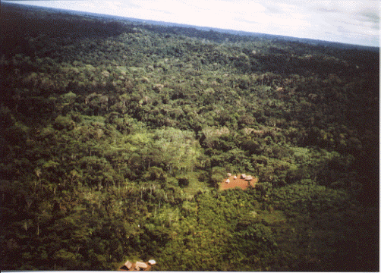
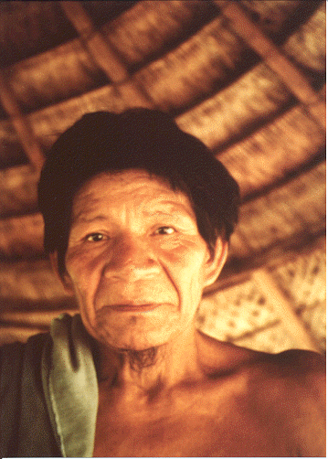
Shiwiar life

Slide 63
Results: Shiwiar villagers versus Harvard undergraduates
Sugiyama, Tooby & Cosmides, PNAS 2002

Slide 64
Shiwiar are not choosing indiscriminately...
Holding logical category constant:
Shiwiar always chose a card more frequently when it was relevant to cheater detection than when it was not.
(Test by comparing performance on standard vs. switched social contracts)

Slide 65
Adaptations are aspects of the phenotype that were designed by natural selection
What counts as evidence?
To show that an aspect of the phenotype is an adaptation, one must produce evidence that it is well-designed for solving an adaptive problem that the species faced in the past.
E.g., to say that an organism has cognitive procedures that are adaptations for detecting cheaters:
One must show that these procedures are well-designed for detecting cheaters on social contracts.
One must also show that their design features are not more parsimoniously explained as byproducts of cognitive processes that evolved to solve some other kind of problem, or a more general class of problem.

Slide 66
Evidence of Special Design
The cognitive programs governing reasoning about social contracts have the following design features:
(all predicted in advance)
They operate even in unfamiliar situations.
They embody implicational procedures specified by the computational theory (entitlement, obligation; switched SCs)
They have procedures specialized for cheater detection.
These procedures are neurally dissociable.
These procedures are found cross-culturally.
The definition of cheating they embody is content-dependent. (accepting a benefit without satisfying the requirement)

Slide 67
Evidence of Special Design, continued
This definition is perspective-dependent.
The cheater detection procedures cannot detect violations of social contracts that are unlikely to reveal a cheater (no innocent mistakes)
The algorithms do not operate so as to detect cheaters unless the rule has been assigned the cost-benefit structure of a social contract (no benefit, no effect)
The algorithms are as good at computing the cost-benefit representation of a social contract from the perspective of one party as from the perspective of another.
Precocial competence (3 & 4 year olds; Nunez & Harris)
They do not include altruist detection procedures.

Slide 68
Byproduct Hypotheses
A number of byproduct hypotheses have been empirically eliminated. For example:
Familiarity cannot explain the social contract effects.
Logic cannot explain the social contract effects. That is, social contract content does not merely facilitate the application of the rules of inference of the propositional calculus.
Content-independent deontic logic cannot explain the social contract effects. E.g., permission schema theory cannot explain them.
(Not good at just any social rule)
Social contract content does not merely “afford” clear thinking.
Content-independent forms of relevance theory cannot explain the social contract effects (see Fiddick, Cosmides & Tooby, 2000, Cognition)
The mere presence of payoffs does not elicit the detection of violations.
That is, no content-independent, domain-general, “blank slate”-type theory can explain the social contract effects.

Slide 69
Conclusion
The human mind contains a neurocognitive adaptation that is functionally specialized for reasoning about social exchange, which includes a subroutine for detecting cheaters.
This neurocognitive system reliably develops in the human cognitive architecture in a species-typical manner. (It is one component of human nature).

Slide 70
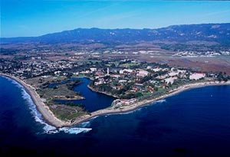
Thank you!
Some other research at the CEP:
Kin detection: altruism & incest aversion
Computational approach to motivation: anger, guilt
Coalitional psychology (“us” versus “them”)
Collective action & free riders
Judgment under uncertainty
Predator-prey reasoning
Visual attention to animals
Precautionary reasoning
Moral sentiments
Memory systems
  Scope hypothesis
  Personality system, self
Center for Evolutionary Psychology website:
www.psych.ucsb.edu/research/cep

Slide 71
Domain-specific social contract algorithms: Built by a domain-general learning process?
Each alternative theory posits different evolved machinery and, therefore, makes different predictions.
Domain-general processes are content-free. They get all of their content from the environment experienced by individual organisms.
Therefore the content of schemas built, and the kind of schemas built, should reflect the statistical distribution of problems found in a given (modern) society.
It should not reflect the distribution of problems found under ancestral circumstances.
What is there to be afraid of? Chicago children, Maurer, 1965

Slide 72
Domain-specific social contract algorithms: Built by a domain-general learning process?
The dog that did not bark. Domain general learning predicts:
There should be permission schemas: permissions are, by definition, more common than social contracts. (But these do not develop). (Also: Why not be good at violations that are mistakes?)
People should be good at detecting events in which someone was cheated—regardless of the violator’s intentions (etc)!
Need to explain precocious emergence. (Why cheater detection, when preschoolers think the word needle is sharp; water is not conserved; there are more daisies than flowers; etc.)

Slide 73
Domain-specific social contract algorithms: Built by a domain-general learning process?
The dog that did not bark. Domain general learning predicts:
There should be schemas for detecting violations of conditionals from other currently important domains. (e.g., trouble-shooting in fixing appliances should yield schemas good at detecting violations of causal rules. These do not appear to exist.)
Should see variation across cultures, with the SC algorithms developing in some but not others. (Seems universal)

Slide 76
Violating a social contract is an EVENT in which someone has been cheated
“If you accept benefit B from me, then you must satisfy my requirement R”
Violating the social contract =
  Taking benefit B from provisioner
  without satisfying the provisioner’s requirement R
Provisioner of benefit imposes requirement because satisfying it creates a situation that benefits the provisioner
Violation deprives provisioner of expected benefit
Violation = Event in which provisioner has suffered a loss

Slide 77
Design feature: Cheating versus Innocent Mistakes
In both conditions, the rule is a social contract:
If a student is to be assigned to Dover High School, that student must live in Dover City.
Context explains:
Dover High is a good school, Hanover High is not
People living Dover City pay high taxes to support this good school. People living in Hanover and other cities do not.
What varies? The potential rule violator.
Cheater condition: Mothers with high school age children have volunteered to sort documents at the local board of education; some may have sorted their own children’s documents, may have cheated.
Innocent mistake condition: Sweet but absent minded elderly ladies who work at the board of education are sorting the documents. They may have made some mistakes.
Forthcoming. Inspired by Gigerenzer & Hug, 1992

Slide 78
Results: Cheating versus Innocent Mistake
Social Contract Rule
Cheating by design, not by mistake
Not –ve payoff
Not permission schema
Not logic
Not relevance theory
Cheating
Mistake
Cosmides, Barrett, Tooby, forthcoming; Barrett, 1999

Slide 79
A cheater is:
An agent who
Takes the rationed benefit offered in a social exchange
But fails to meet the provisioner’s requirement
And does so by intention/ calibration rather than by mistake or accident
i.e., an agent with a disposition to cheat
  By virtue of his/her calibration or design

Slide 80
Accidental failures to reciprocate…
Result in cheating
Without revealing presence of a cheater
An EVENT has occurred in which the provisioner has not gotten what he is entitled to
  Provisioner has been cheated
Without revealing the presence of a PERSON with a disposition to cheat
Innocent mistakes can dissociate
  event categorization (someone was cheated)
  from person categorization (cheater detection)

Slide 81
Evolutionary perspective predicts:
Mechanism for detecting cheaters
  Person categorization
Strongly activated when there are cues that the violator:
  Intends to violate
  Would get the Benefit offered by the provisioner
  Has the Ability/opportunity to violate
    Situation versus dispositional attribution
More weakly activated as these cues are removed
  Accidental violations, no benefit, no opportunity

Slide 82
What would other theories predict?
General skill acquisition
  Economic perspective
  Utility consequences
  Common sense!

Slide 83
General skill acquisition: Economics, utility consequences (& common sense!)…
Become skilled at solving problems one is motivated to solve, such as those with economic consequences
When target violates a social contract, provisioner suffers a loss in utility
  If these cases are detected, P could get what he is owed, recoup loss
A lifetime of not getting what you are entitled to should build skill at detecting violations of social contracts—cheating events

Slide 84
Cue-activated system
Each cue independently and additively contributes to activation of the cheater detection system
  Best performance when:
  Violator would get Benefit regulated by social contract + Intends to violate + has Ability to violate
  Removing 1 cue drops ~20 points; 2 cues drop ~40 points
Inadequacy of “consequences for utility”
  These exist in all cases (Board doesn’t get what it wants—presumably to incentivize tax support)
  In Benefit present conditions, also true that violators are getting an unearned benefit
  Yet removing Intention and Ability drops performance!

Slide 85
Results rule out all deontic counter-theories
These depend on whether the rule is interpreted as being a deontic rule, or a deontic rule with utilities
All rules had the exact same interpretation: as a social contract (deontic with utilities)
Yet performance dropped when looking for violations would not reveal individuals with disposition to cheat

Slide 86
Person categorization, not event categorization
General skill acquisition (economics, utility consequences, common sense) predicts:
  Experience of being cheated causes you to develop skills that allow you to detect events in which someone has been cheated
In every case, looking for violations will reveal an event in which provisioner was cheated
Yet violation detection was not high in all cases
  Drops when searching for violations is unlikely to reveal individuals with a disposition to cheat
  Person categorization!—the evolutionary function

Slide 87
Implication of intentionality exps:
Mechanism is functionally designed to look for cheaters—individuals with a disposition to cheat
Just how specialized is the cheater detection mechanism?
It’s so freakin’ specialized!

Slide 88
Cheating versus Innocent Mistake
What do the results mean?
Cheating by design, not by mistake
Not just looking for events in which someone was cheated or got a negative payoff
Not a permission schema (all were permission rules)
Not all deontic rules involving utilities
Not logic
Cosmides, Barrett, Tooby, 2010

